Slide 1
Microsoft Project 2007
Working with Tasks

Slide 2
Objectives
Task duration.
Milestones Tasks
Summary tasks and subtasks
Adding notes to tasks
Task Relationship/Dependency
  Link Tasks
  Set dependency
Create a schedule

Slide 3

Adding Tasks to a Project
When you add a task,
  For every new task you add, Project 2007 assigns a duration of one day.
  The question mark in the Duration column indicates that this is an estimated duration.
  The Gantt Chart displays a corresponding task bar of one day’s length.
  By default, the start date of the task is set to the start date of the project.
  The task is automatically assigned an ID number. This ID number is unique to each task.
  However, the ID number does not necessarily represent the order in which the tasks occur.

Slide 4


Task duration
Time Duration Abbreviation
  Minute – ‘m’ appears as min in the project plan
  Hour – ‘h’ appears as hr in the project plan
  Day – ‘d’ appears as day in the project plan
  Week – ‘w’ appears as wk in the project plan
  Month – ‘mo’ appears as mon in the project plan
  To change appearance on project plan, go to Tools → Options → Edit

Slide 5
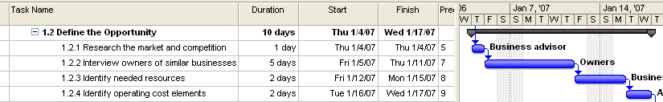
Specifying task duration
Guidelines for task estimates/duration
  It is advisable to specify the task durations ranging from one day to 10 days.
  Tasks that require less than one day for completion will be too granular,
  Tasks that require more than 10 days to complete might be too long to be managed properly.
Notes:
1. Task duration guideline
2. WBS Vs Activities

Slide 6
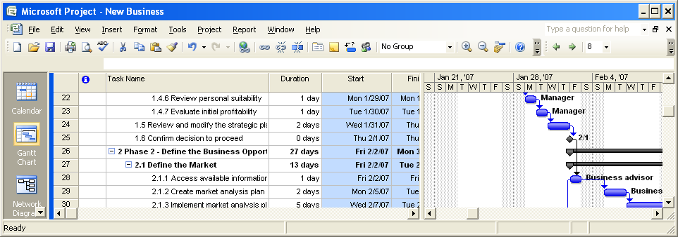
Milestone
Milestones indicate important events of your project. For example, a milestone can indicate the end of one phase of the project
A milestone is represented as a task with zero duration because the milestone usually does not involve any work.

Slide 7
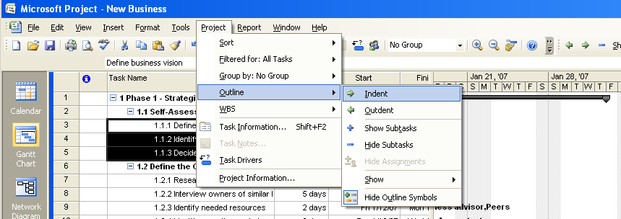
Summary and Sub tasks
Select the tasks that you want to group into a phase, and then indent the tasks.
The task that appears before the first indented task becomes the summary task.
The summary task name is formatted in bold and a summary task bar appears in the Gantt Chart.
Project 2007 calculates the duration of a summary task as the period between the start date of the subtask that is scheduled to start first and the finish date of the subtask that is scheduled to finish last
Work for summary task is calculated by summing up work of all sub tasks
Summary Task
Sub Tasks
Notes:
WBS ID

Slide 8

Task notes
Task notes provide addition information about the task. Often it is an information that is required to perform the task or it helps performing the tasks
Can be used as WBS dictionary
Adding task notes
  Select the task for which you want to provide additional information
  On the Project menu, click Task Notes or Right click on task and select task notes in context menu
  Type the required information, and then click OK.
  A note icon appears in the Indicators column for the selected task. Point to the note icon. The note appears as a ScreenTip.

Slide 9





Task Relationship/Dependency
There are 4 type of relationship
Finish to Start (FS) Finish date of the predecessor task determines the start date of the successor task.
Start to Start (SS) Start date of the predecessor task determines the start date of the successor task
Finish to Finish (FF) Finish date of the predecessor task determines the finish date of the successor task
Start to Finish (SF) Start date of the predecessor task determines the finish date of the successor task
Notes:
Examples
SIT → UAT →
→ DOC → Deployment

Slide 10
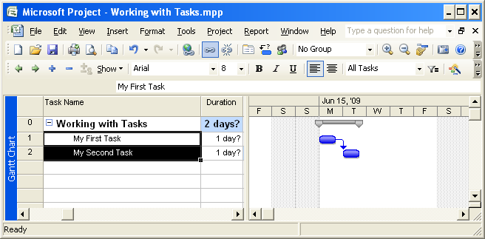
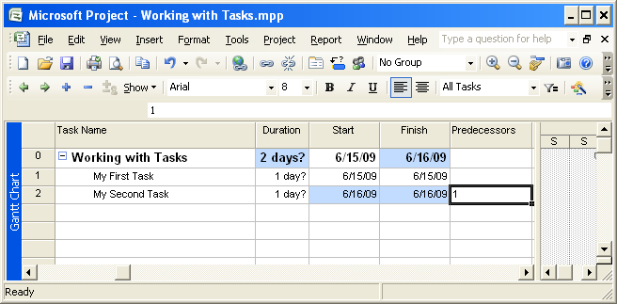
Linking Task
Select the predecessor
Hold the control key and select successor
Click Link Tasks on Tool Bar or Click Edit → Link Tasks
Select the successor Task
Go to Predecessor column
Enter the task id number of predecessor
Notes:
Show using MSP

Slide 11
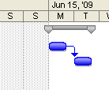
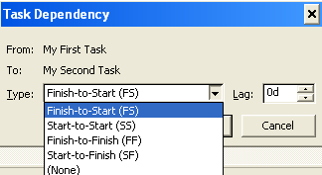
Changing Dependency/Relationship
Once tasks are linked, you can set the relationship you want
Double click on link to display Task Dependency dialog box
Select the dependency
Specify the lead/lag if any
To specify lag, enter a positive value and negative value for lead
Lag/Lead
Notes:
Show using MSP

Slide 12
Objectives
Task duration.
Milestones Tasks
Summary tasks and subtasks
Adding notes to tasks
Task Relationship/Dependency
  Link Tasks
  Set dependency
Create a schedule

Slide 13
Questions
You have created a project plan for your project. For this project, Task 10 must start when Task 5 finishes and Task 10 must finish when Task 7 finishes. What relationship will you specify between these tasks?
Select the best answer
  FS relationship from Task 10 to Task 5 and FF relationship from Task 10 to Task 7.
  FS relationship from Task 5 to Task 10 and FF relationship from Task 10 to Task 7.
  FS relationship from Task 10 to Task 5 and FS relationship from Task 7 to Task 10.
  SF relationship from Task 5 to Task 10 and FF relationship from Task 10 to Task 7.
  ✓

Slide 14
Questions
In your project plan, you have added a task with the duration of 0d. What is this task called?
Select the best answer
  Predecessor.
  Successor.
  Milestone.
  Summary task.
  Subtask
  ✓

Slide 15
Questions
All tasks in deployment phase are in sequence. What is the fastest way to specify dependencies for all the tasks?
Select the best answer
  Task Information Dialog Box
  Enter Ids
  Link Tasks
  ✓

Slide 16
Trick of the Trade
Use template to save time from Repetitive work like
  Standard Project Option
  Standard Organization Calendar
  Standard Task to be executed on almost all projects
It is good to do forward planning specifying start date in Project Information. Allow Project 2007 to calcualte dates for other tasks and end date
Do not enter start and end date for individual task, let’s manage this with dependencies
Minimize constraints. Manage by specifying dependencies
Following the below sequence to create a schedule
  Create a WBS → List Activities → Specify Milestones → Enter Task Estimates → Specify dependencies → Assign Resources

Slide 17
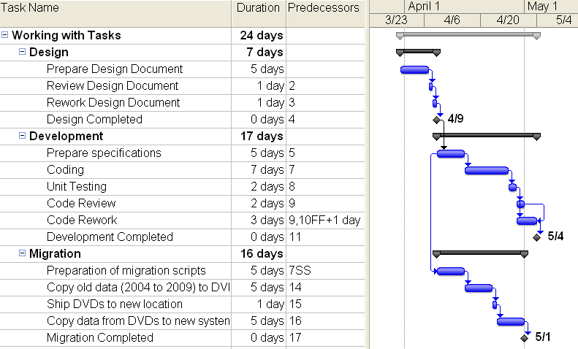
Lab: Create a schedule
Create a new project and prepare schedule as below
  Create a new project and specify a start date
  Change date format for the project to “m/d/yy” and show project summary task
  Setup standard calendar as project calendar and mark 26Jan, 15Aug & 2Oct as National Holidays
  Create the schedule as below

Slide 18
Objectives
Task duration.
Milestones Tasks
Summary tasks and subtasks
Adding notes to tasks
Task Relationship/Dependency
  Link Tasks
  Set dependency
Create a schedule

